Slide 1

SafeMessage System
Team 4: Luke Skorupski and Matt Roth

Slide 2
Introduction
Purpose
  Secure messaging for bankers, brokers, lawyers and other professionals
Functional Requirements
  Three security levels
  Message sending
  Broadcasting
Non-functional requirements
  Security
    Unspoofable between machines
  Guarantee of delivery
  Concurrency

Slide 3
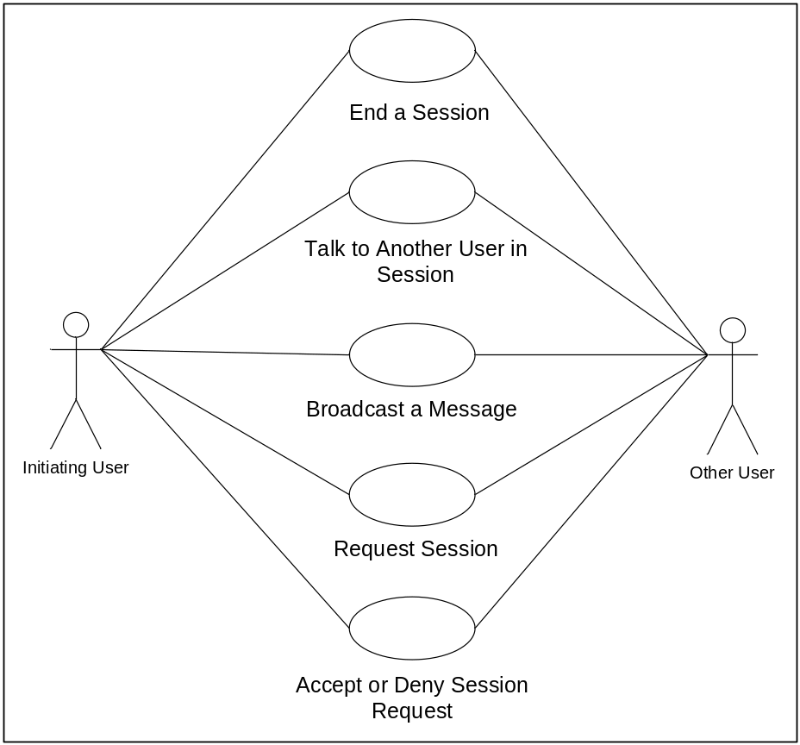
Use Case

Slide 4
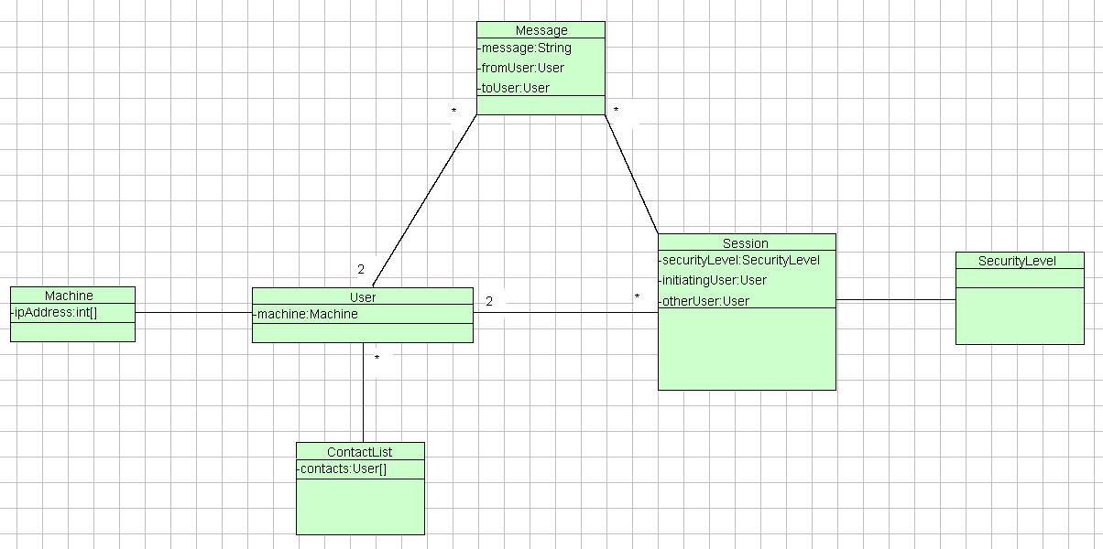
Conceptual Model

Slide 5
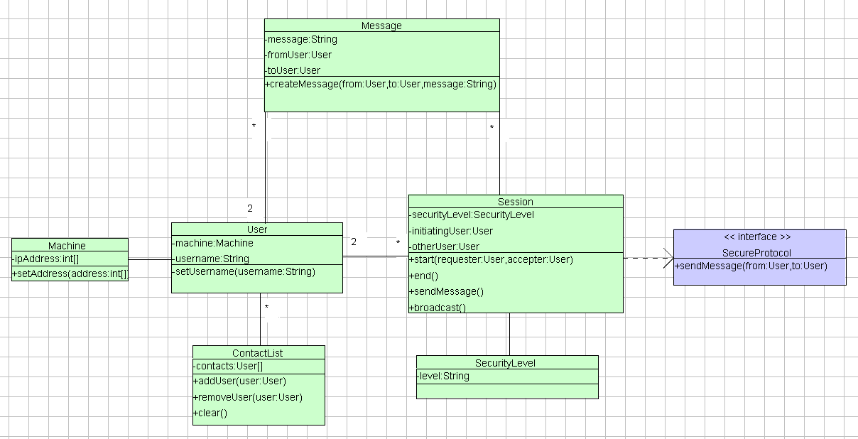
User-based Class Model

Slide 6
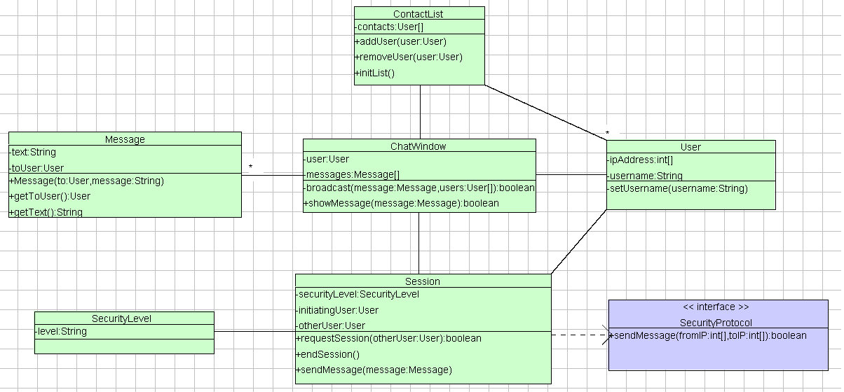
Interface-based Class Diagram

Slide 7
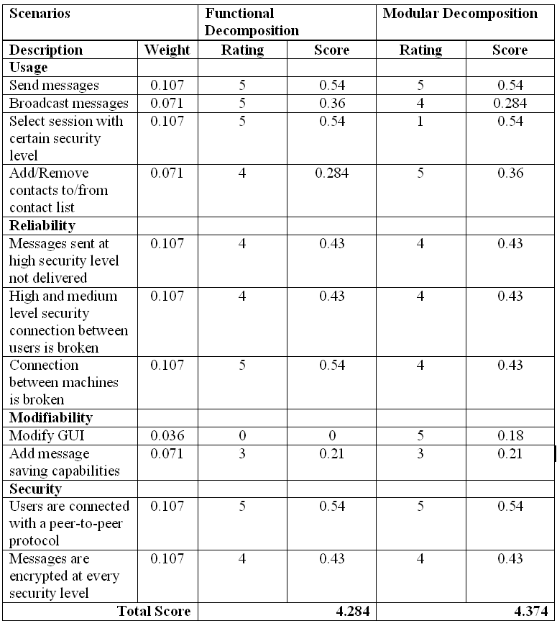
Profiles and Scenarios
Profiles and Scenarios
Profiles and Scenarios

Slide 8
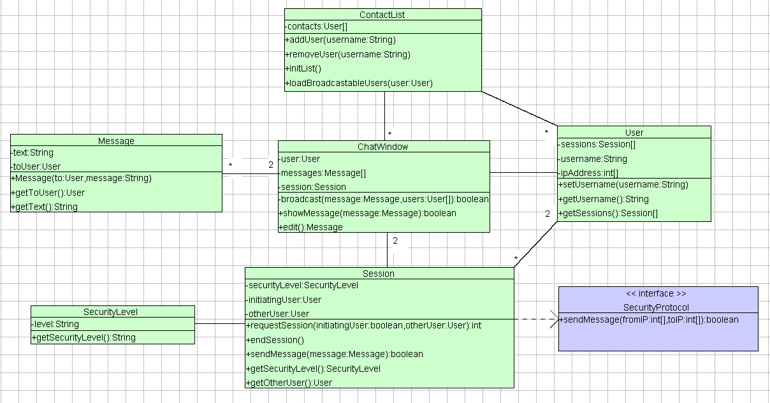
Detailed Class Diagram

Slide 9
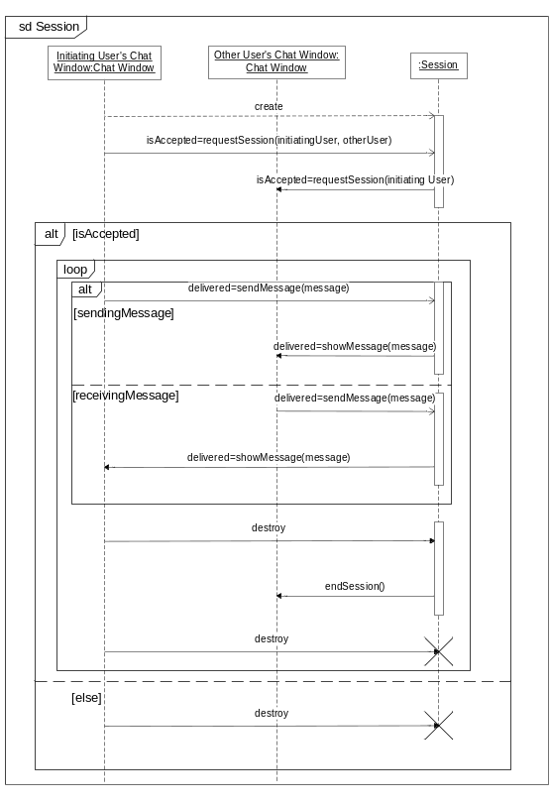
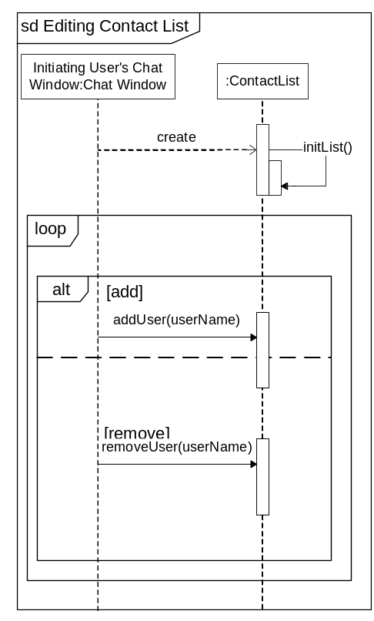
Sequence Diagrams

Slide 10
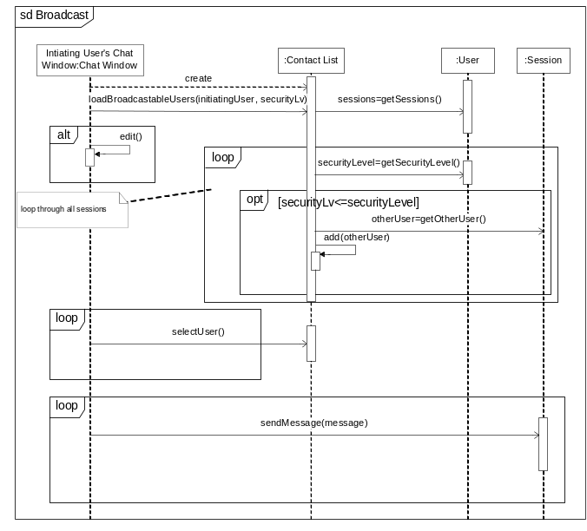
Sequence Diagrams (cont.)

Slide 11
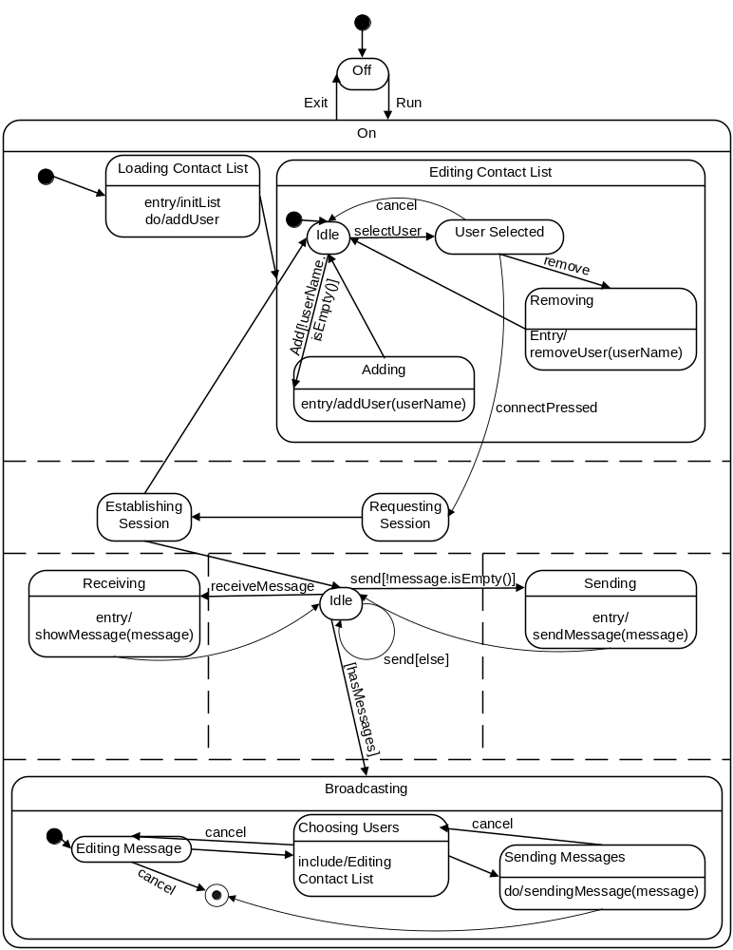
State Diagram

Slide 12
SafeMessage System
Team 4: Luke Skorupski and Matt Roth

